Slide 1
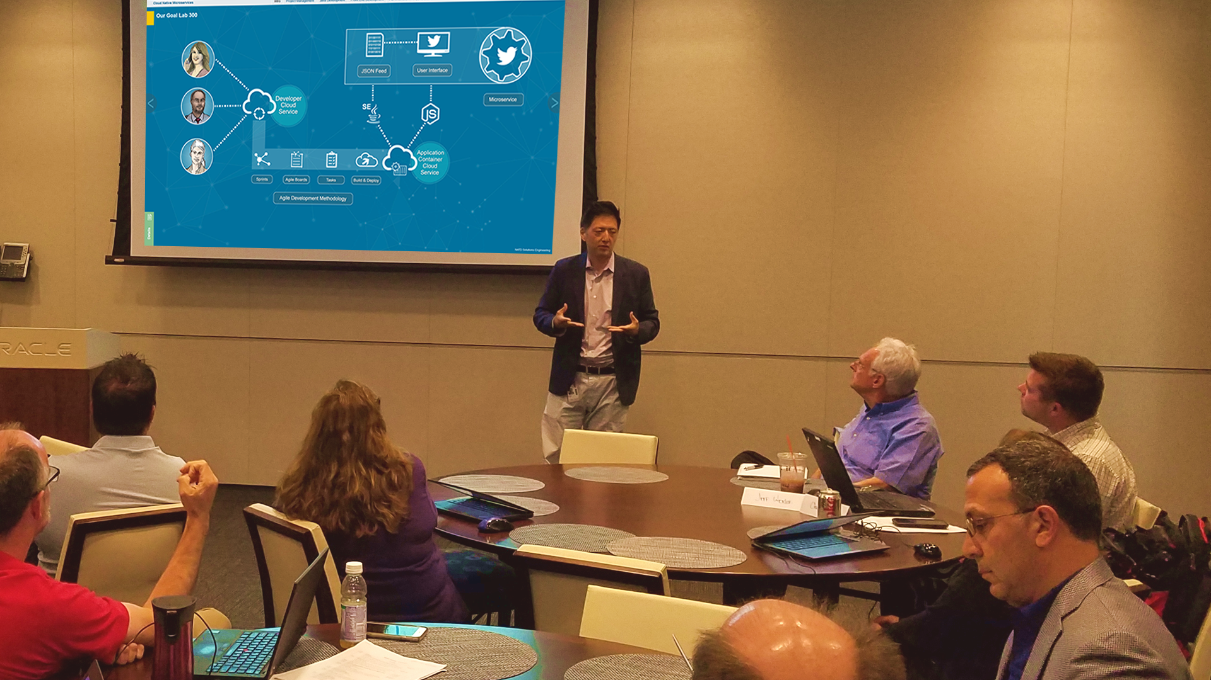

Enablement
Cloud Native Microservices Workshop
Notes:
Add a Picture from your cell phone of the experience teaching a workshop.

Slide 2
Our Idea:
Modernize Infrastructure Deployments
Confidential – Oracle Internal
2

Slide 3
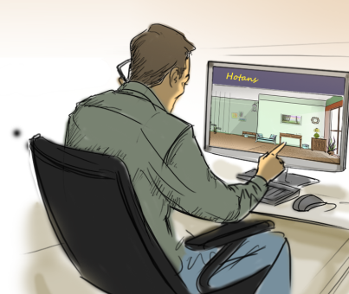


Modernized Infrastructure Deployments
at Alpha Office
Install/Configure
Linux
Patrick
OS Developer
Docker
Notes:
Narrative:
At Alpha Office we often face delays getting the core environments up and running for our developers. With specialized skill sets, corporate policies and in-flight workloads it sometimes takes days for a OS to be installed, added to the network and enabled for use. We feel leveraging Docker/Oracle Cloud approach could enable re-usable configurations that would speed up IT delivery and enable more consistant operations. Our idea to modernize infrastructure deployments begins with the ability for our OS Developers to properly install the Linux OS as a capability for the container.

Slide 4


Modernized Infrastructure Deployments
at Alpha Office
Install/Configure
Linux
Patrick
OS Developer
Docker
Install/Configure
12c
Paul
DBA
Notes:
Narrative:
Once our OS capability is completed, our DBA’s would create a capability with our corporate standards in place for the 12c database.

Slide 5
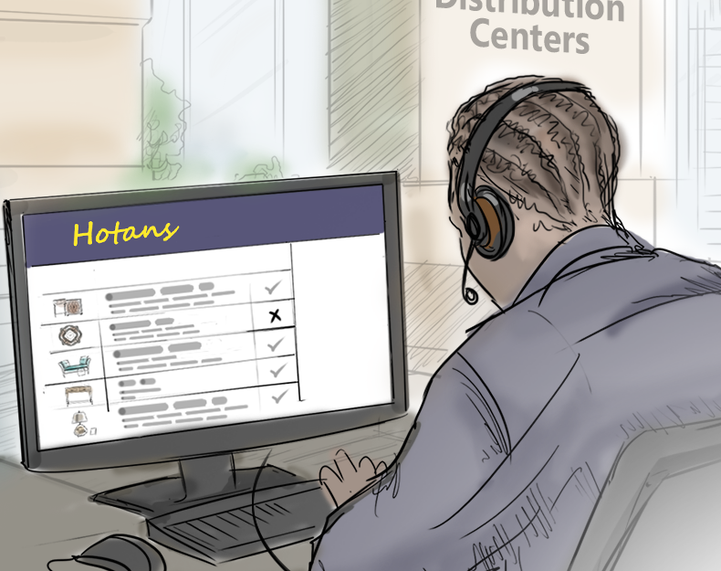

Modernized Infrastructure Deployments
at Alpha Office
Install/Configure
Linux
Patrick
OS Developer
Install/Configure
WebLogic
Docker
Jay
WLS Admin
Install/Configure
12c
Paul
DBA
Notes:
Narrative:
Last but not least our WebLogic Admin could build a capability for the container to run WLS 12c.

Slide 6



Modernized Infrastructure Deployments
at Alpha Office
Install/Configure
Code Testing/QA
Linux
Compute
Cloud Service
Deploy
Patrick
OS Developer
Install/Configure
Development Environment
WebLogic
Docker
Jay
WLS Admin
Ashley
Developer
Install/Configure
12c
Paul
DBA
Notes:
Narrative:
The beauty of this architecture is that all our capabilities can be created in a manner that both adheres to IT standards but also enables our developers to quickly choose the combination of capabilities they need for a specific project. Our developers can quickly build a Docker container with the specific features they need and run the container locally on in-house servers if there is capacity or more likely push the container to the Oracle Cloud. With the Cloud we feel our developers could have a working personalized environment up and running in an about an hour. Once then environment is running they will have the flexibility to immediately develop or quickly delete and re-build the containers from scratch as and when needed for Q/A and test environments.

Slide 7


Repeatability
Deployment
Recovery
Network
Easily create consistent containers
Deployed to the Cloud faster than expected.
Development issues can be blown away and recreated with ease.
Ports may need to be opened for seamless Cloud Deployment.
Standardized deployment
methodology
The deployment was easy to manage and access.
Lessons Learned
Notes:
Narrative:
We learned four lessons during our Accelerate journey. First, this architecture is highly repeatable. It really provides a nice way for use to create consistant containers based on our IT standards. Second, deployment of environments is much easier than our current process, especially if we are able to leverage the cloud and the existing management interfaces. Third, is the ability to recover from errors. No one is perfect in development, and sometime small mistakes have costs days or weeks of troubleshooting. With Oracle we could simply delete and rebuilt the container knowing all the standards are in place. Last but not least is networking, if we implement this idea, we will need to coordinate with the networking team and possibile open/secure communication ports to the cloud.

Slide 8
Coordinate on POC
Setup a Developer Cloud Service Account
Next Steps
Migrate and Test a In-house Development Environment
Schedule/Attend SDLC Hands-On Workshop
Notes:
Narrative:
After completing our Accelerate we would reccomend four next steps to continue learning and pursue your idea.

Slide 9




Business Value
Quality of Service
Agility
Dev Ops will allow value to be provided more quickly.
Sprints
Time to Value, Time to Market
Improved ability to fix bugs.
Improvement to performance or availability
Improved security
Standards and consistency helps more easily identify problems and correct
Innovation
Cost
More with Less
Faster, Cheaper
More easily create improved customer services, cross sell, etc. opportunities
Mobile
New Sales retention capabilities
Notes:
Narrative:
By implementing your idea in the Cloud, we feel you will improve your quality of service, increase agility, innovate faster and reduce costs.

